Slide 1
Sentiment Analysis Using BERT and Multi-Instance Learning
Iryna Burak
Pablo Restrepo
July 6, 2020

Slide 2
Presentation Overview: What did we do on the last 2 weeks?
Generating BERT multilingual contextual embeddings for our sentences using the entire comment as context.
Updating and running our simple baselines.
Training out MilNet ignoring ‘neutral’ class.
Simple NN as baseline for our organic data.
Training our MilNet using the new contextual embeddings.
References.

Slide 3
Generating BERT multilingual contextual embeddings
Model used: BERT multilingual cased.
Method used to extract the embeddings:
Generate contextual embeddings for each token, using the entire comment as context.
For each sentence, use the mean of its tokens as embedding.

Slide 4
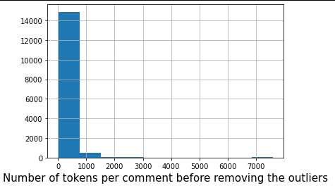
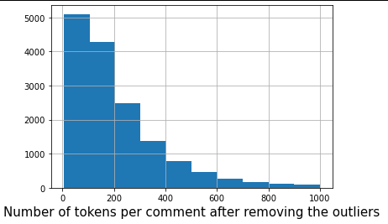
Generating BERT multilingual contextual embeddings
BERT can not handle sentences with more than 512 tokens, including [CLS] and [SEP].
For Amazon EN:

Slide 5
Generating BERT multilingual contextual embeddings
BERT can not handle sentences with more than 512 tokens, including [CLS] and [SEP].
For Amazon EN:
Number of comments with more than 510 tokens: 1455
Total number of comments: 15561
Percentage of comments with more than 512 tokens: 9.3%
Total number of sentences: 131349
Number of sentences lost after removing comments with more than 510 tokens: 37817 (34%)

Slide 6
Generating BERT multilingual contextual embeddings
BERT can not handle sentences with more than 512 tokens, including [CLS] and [SEP].
For Amazon DE:
Only 2 comments had more than 510 tokens.

Slide 7
2. Updating and running our simple baselines
2.1 Baselines ignoring neutral class
Sentiwordnet
VADER
metric | amazon EN | organic
F1 (micro) | 0.617 | 0.585
F1 (macro) | 0.482 | 0.562
metric | amazon EN | organic
F1 (micro) | 0.592 | 0.655
F1 (macro) | 0.485 | 0.649
Textblob DE
metric | amazon DE
F1 (micro) | 0.549
F1 (macro) | 0.496

Slide 8
2. Updating and running our simple baselines
2.1 Baselines ignoring neutral class
 | F1 (micro) | F1 (macro)
amazon EN -> amazon EN | 0.549 | 0.592
organic -> organic | 0.482 | 0.578
amazon EN -> organic | 0.607 | 0.394
amazon DE -> amazon DE | 0.579 | 0.578
NLTK sentiment analyzer
 | F1 (micro) | F1 (macro)
amazon EN -> amazon EN | 0.658 | 0.658
organic -> organic | 0.640 | 0.622
amazon EN -> organic | 0.614 | 0.473
amazon DE -> amazon DE | 0.690 | 0.690
Scikit-learn SVM model

Slide 9
2. Updating and running our simple baselines
2.2 Baselines with neutral class
Sentiwordnet
VADER
metric | amazon EN | organic
F1 (micro) | 0.329 | 0.384
F1 (macro) | 0.273 | 0.376
metric | amazon EN | organic
F1 (micro) | 0.473 | 0.480
F1 (macro) | 0.340 | 0.442
Textblob DE
metric | amazon DE
F1 (micro) | 0.371
F1 (macro) | 0.366

Slide 10
2. Updating and running our simple baselines
2.2 Baselines with neutral class
 | F1 (micro) | F1 (macro)
amazon EN -> amazon EN | 0.382 | 0.370
organic -> organic | 0.45 | 0.437
amazon EN -> organic | 0.356 | 0.187
amazon DE -> amazon DE | 0.406 | 0.399
NLTK sentiment analyzer
 | F1 (micro) | F1 (macro)
amazon EN -> amazon EN | 0.474 | 0.474
organic -> organic | 0.456 | 0.436
amazon EN -> organic | 0.378 | 0.282
amazon DE -> amazon DE | 0.482 | 0.479
Scikit-learn SVM model

Slide 11
Training out MilNet ignoring ‘neutral’ class
XLING without fine-tuning: 2 classes
metric | amazon EN | amazon DE | organic
F1 (micro) | 0.813 | 0.820 | 0.643
F1 (macro) | 0.804 | 0.820 | 0.640
XLING without fine-tuning: 3 classes
metric | amazon EN | amazon DE | organic
F1 (micro) | 0.583 | 0.619 | 0.376
F1 (macro) | 0.563 | 0.549 | 0.369

Slide 12
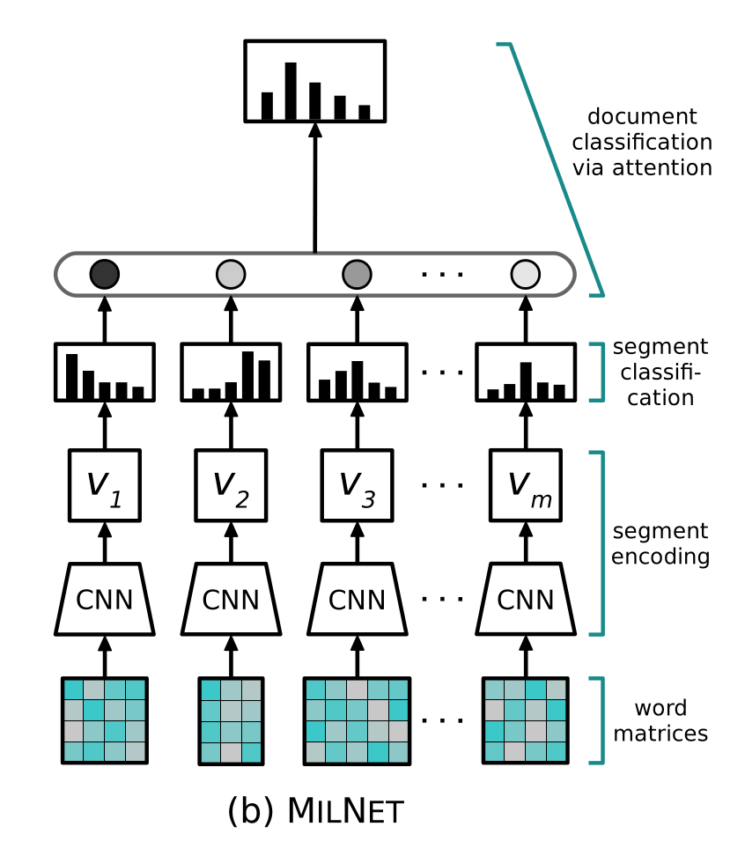
Simple NN as baseline for our organic data
GRU + linear
single segment
BERT
BERT
Angelidis S. & Lapata M, Multiple Instance Learning Networks for Fine-Grained Sentiment Analysis, University of Edinburgh

Slide 13
Simple NN as baseline for our organic data
baseline: 2 classes
XLING with fine-tuning: 2 classes
metric | organic
F1 (micro) | 0.714
F1 (macro) | 0.713
metric | amazon EN | amazon DE | organic
F1 (micro) | 0.725 | 0.775 | 0.704
F1 (macro) | 0.705 | 0.774 | 0.703
baseline: 3 classes
XLING with fine-tuning: 3 classes
metric | organic
F1 (micro) | 0.612
F1 (macro) | 0.612
metric | amazon EN | amazon DE | organic
F1 (micro) | 0.467 | 0.551 | 0.543
F1 (macro) | 0.440 | 0.505 | 0.530

Slide 14
Training our MILNET using the new contextual embeddings
with fine-tuning
contextualized: 2 classes
with fine-tuning
non-contextualized: 3 classes
metric | F1 (micro) | F1 (macro)
amazon EN | 0.630 | 0.629
amazon DE | 0.584 | 0.499
nc organic | 0.704 | 0.701
metric | F1 (micro) | F1 (macro)
amazon EN | 0.317 | 0.281
amazon DE | 0.334 | 0.301
organic | 0.539 | 0.519
with fine-tuning
contextualized: 3 classes
metric | F1 (micro) | F1 (macro)
amazon EN | 0.429 | 0.377
amazon DE | 0.444 | 0.316
nc organic | 0.555 | 0.543

Slide 15
Training our MILNET using the new contextual embeddings
without fine-tuning
contextualized: 2 classes
without fine-tuning
non-contextualized: 3 classes
metric | F1 (micro) | F1 (macro)
amazon EN | 0.793 | 0.776
amazon DE | 0.688 | 0.684
nc amazon DE | 0.676 | 0.673
metric | F1 (micro) | F1 (macro)
amazon EN | 0.573 | 0.556
amazon DE | 0.503 | 0.415
without fine-tuning
contextualized: 3 classes
metric | F1 (micro) | F1 (macro)
amazon EN | 0.564 | 0.545
amazon DE | 0.519 | 0.482
nc amazon DE | 0.516 | 0.494

Slide 16
References
Angelidis S. & Lapata M, Multiple Instance Learning Networks for Fine-Grained Sentiment Analysis, Institute for Language, Cognition and Computation School of Informatics, University of Edinburgh.

